Slide 1
MACHINE LEARNING
Feature Engineering

Slide 2
Feature Engineering
It is most important technique used in creating machine learning models.
It helps to increase accuracy of the models.
It performs better on data than basic machine learning odels.

Slide 3
There are two types of techniques of feature engineering
Imputation
Encoding

Slide 4
Imputation
Handle missing value.
Imputation is a method of correcting errors and estimating and filling in missing values in a data set.
We use mean, median, mode for handling missing values

Slide 5
Feature encoding
It is the process of transforming a categorical variable into a continuous variable and using them in the model.

Slide 6
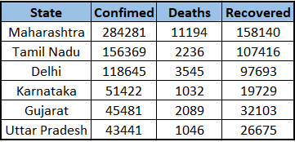
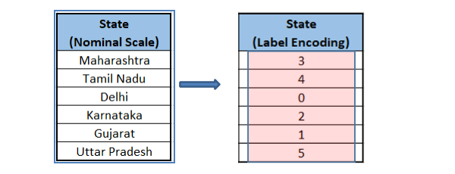
Label encoding:
It used to convert the labels into numeric form.
Which can be easily understood by machine learning algorithm.
E.g.:

Slide 7
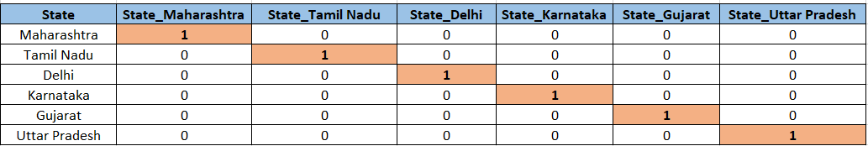
One hot encoding
To overcome the disadvantages of label encoding.
There are two steps to proceed One-hot encoding
Splitting of categories to different columns.
Put ‘0 for others and ‘1’ as an indicator for the appropriate column.
The presence of a class will be represented in binary format.

